Slide 1
Network Artificial Intelligence
Connections - 2017
Vinod Kumar S - Huawei

Slide 2
Network Artificial Intelligence
Telemetry
Telemetry via Streaming
New protocols – gRPC; New technique – Yang Push.
Analytics
Actionable Analytics by SDN, Orchestrator
Messaging Middleware – DDS, Kafka etc
New techniques – In-Situ-OAM
Closed Loop
Real-time mechanism to handle streaming data
Big Data techniques to store telemetry
AI/ML techniques for analysis
Continuous Feedback and improvements
Loose coupling
Networks autonomous through automation and control loops
Use IT tools and techniques - Beam, Flink, InfluxDB etc

Slide 3
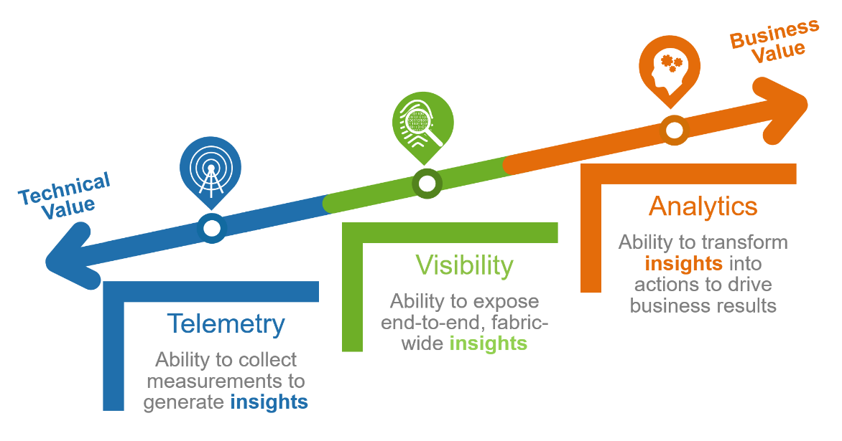
Network Telemetry
What is Telemetry?
Telemetry is an automated communications process by which measurements and other data are collected at remote points and transmitted to receiving equipment for monitoring.
Network Telemetry
Network Telemetry describes how information from various data sources can be collected using a set of automated communication processes and transmitted to one or more receiving equipment for analysis tasks.
Analysis tasks may include event correlation, anomaly detection, performance monitoring, metric calculation, trend analysis, and other related processes.

Slide 4
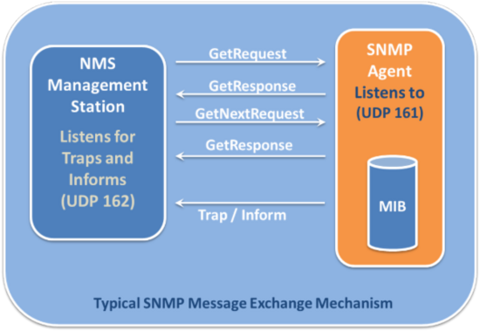
Legacy Telemetry
Query based
Trap support
Limited data
Non streaming

Slide 5
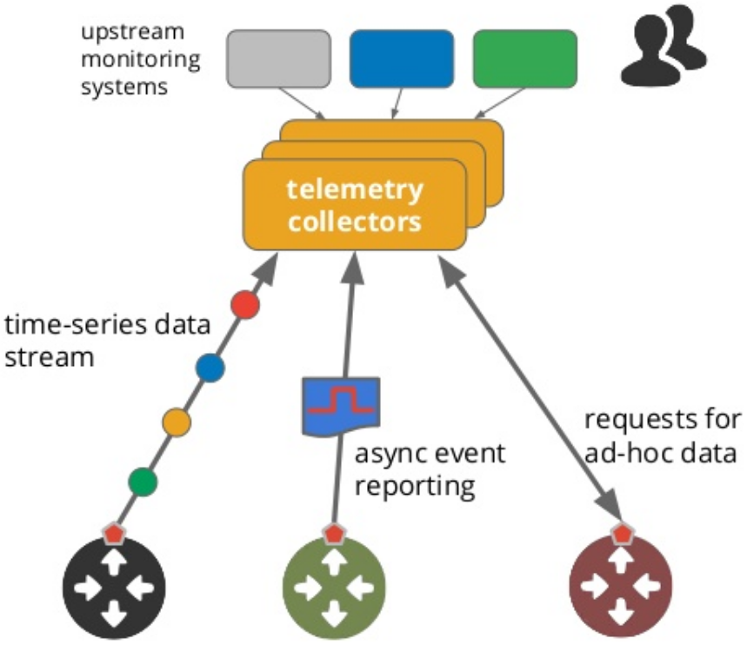
Streaming Telemetry
Streaming
Netconf Restconf YANG
Yang push, gRPC
Publish subscribe

Slide 6
Bus Based transport option
Feature | Standard socket API | Bus based transport
Architecture | TCP: Point to Point UDP: point to point, broadcast or multicast | Publish-Subscribe (multicast)
Discovery of endpoints | IP addresses, port numbers are hardcoded | Dynamic discovery, no need to specify where end points reside
Device management | Management configuration and Application reachability | Management and configuration is simpler, publish to middleware
Device Publishing | One copy per subscription | Single copy per domain.
VNF / PNF 1
Subscriber 1
a
a
VNF / PNF 2
Middleware
b
b c
Subscriber 2
c
a c
VNF / PNF 3
Subscriber 3

Slide 7
Protobuf encoding option
JSON | XML | Protobuf
human readable | human readable | Dense binary
Easily portable | Easily portable | Need target specific compiler
Self contained | Self contained | Schema dependency
Performance expensive | Performance expensive | Performance optimized
Massive data overhead | Massive data overhead | Optimized metadata overhead
VNF / PNF
App
Format
Type consistency
Compatibility
Performance

Slide 8
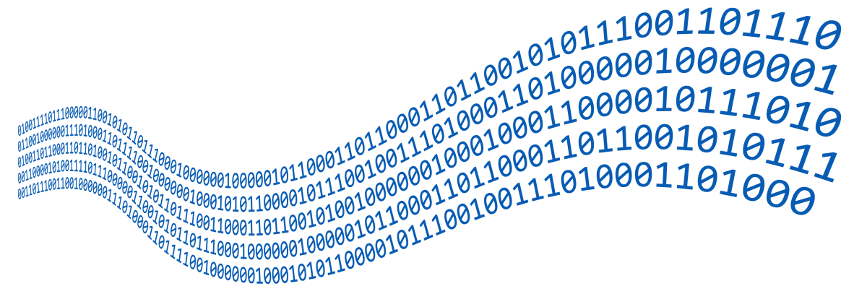
Streaming Analytics

Slide 9
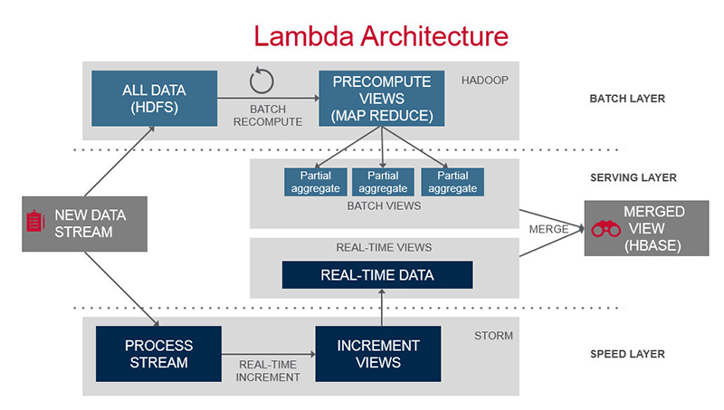
Batch / Lambda Architecture
Batch use cases
Write twice
Data duplication
Late events

Slide 10
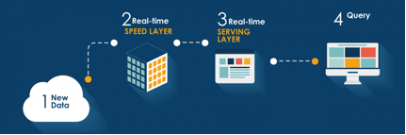
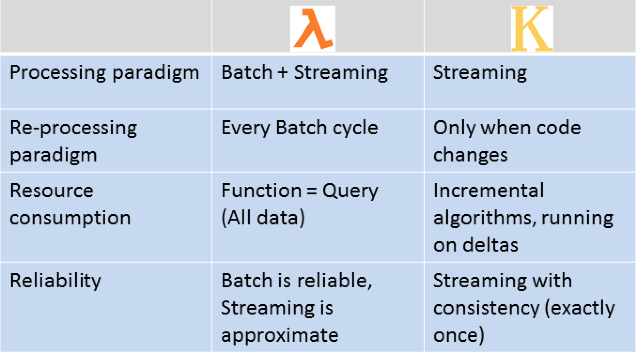
Streaming Analytics (Kappa)
Network Streaming Analytics Use cases
Real-time Anomaly detection and action
Network fault handling
BMP: Route leaks / BGP hijack
Congestion avoidance
AI enabled auto bandwidth
Self healing virtualized networks

Slide 11
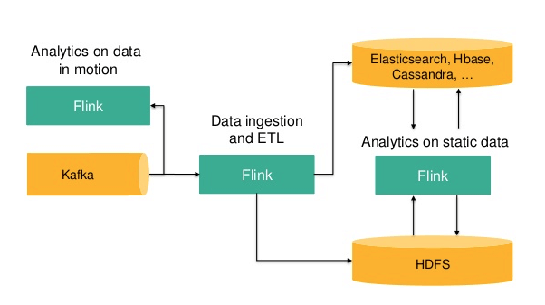
Flink streaming framework
Continuous Processing for Unbounded Datasets
accurate, even in case of out-of-order or late-arriving data
stateful and fault-tolerant
Performs at large scale

Slide 12
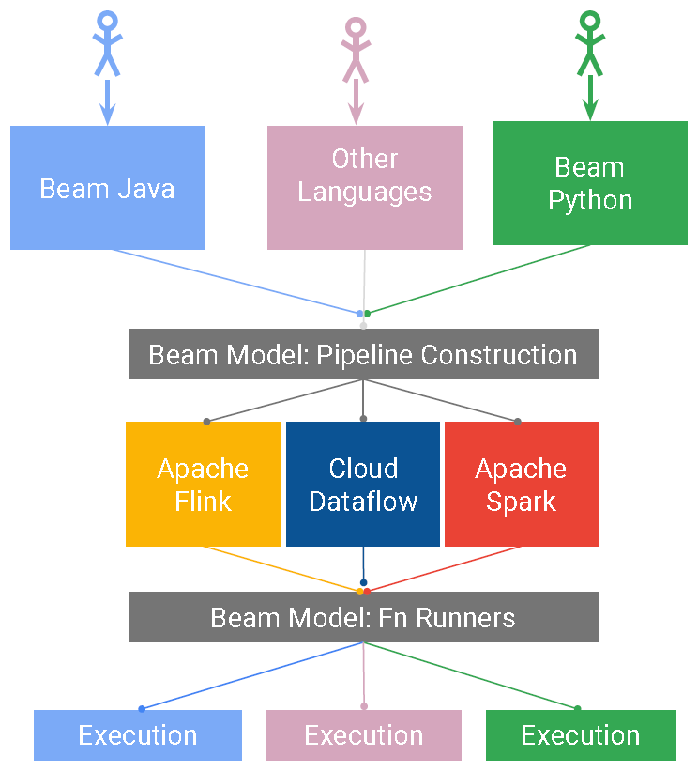
Beam programming model
batch and streaming data processing
run on any execution engine
multi language support
unified programming model

Slide 13
Why a Platform?
Different Telemetry protocols and Mechanism
Realize different use cases quickly by reusing “NTA platform”
Speed and Scale
gRPC, BMP, Syslog etc
Massive scale of network telemetry
Focus on business logic
Hide the internal mechanisms
Ease of adding new telemetry data
Elasticity to scale up or down
Micro-service and container driven architecture

Slide 14
Architecture
Closed Loop
NAI
Management and Orchestration
Data
bus
App 1
App 2
App n
Analytics Platform
Data bus
SDN controller
Collector 1
Collector 2
Collector n
SBI
Collection platform
Telemetry
Network

Slide 15
Closed Loop
Networks autonomous through automation and control loops
Actionable Analytics by SDN, Orchestrator
Continuous Feedback and improvements
ML based analytics for prediction
Self healing

Slide 16







sflow use case
Openflow
Rest
SDN
NTA – Network Telemetry & Analytics
OVS
Traffic Prediction NTA App
management
Sflow
Sflow
Beam
Data Persistence
DDS Sflow
collector
DDS BUS
DDS
Kafka
Flink

Slide 17
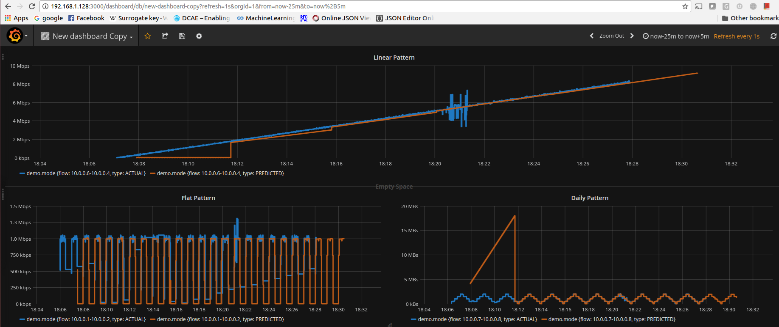
Prediction Snapshot

Slide 18
Looking forward…
IETF
Explore the possibility of bus based transport for telemetry
Evaluate the option of extending the encoding (content type) of telemetry protocols
gRPC/gNMI under IETF
IRTF
Work towards the “proposed” NMLRG research group to discuss the analytics and ML in network
Opensource
Enhance/Reuse network analytics platforms such as DCAE (ONAP), PNDA.
Work with open source machine learning libraries such as tensor flow for network specific use cases.

Slide 19
Thank you
Check out the demo during Hackathon tomorrow!

